Slide 1


Slide 2
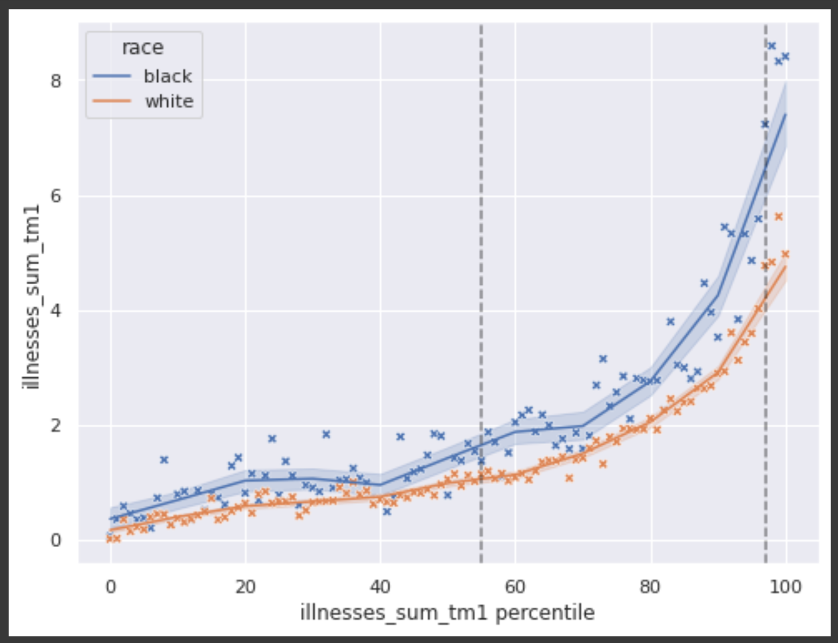
Team #9 - “BluePermanent” - Opening Arguments
There is no intentional discrimination against Jerry as there was no Race feature in the training model.
Even though the two people involved in the case have “similar” medical history, they are not “identical”. This is further emphasized by the fact that the Doctor (human in the loop) also agreed with the diagnosis
Even if there was a de-facto difference, it is not discrimination, as the Race factor makes a clear difference in medical history. (See image)
There was already a fall-back for the algorithm, since patients could ask the Family Practitioner for an exam.

Slide 3
Team #9 - “BluePermanent” - Cross Examination
Why did he want to take the test? What is the medical justification behind it?
Did the fact that your husband was chosen to take the test influence your decision to ask for the test?
Why did you push the doctor to test you even after he agreed with the algorithmic decision?
Do you have more faith in the Human Being than the Machine?

Slide 4
Team #9 - “BluePermanent” - Closing Remarks
Reiterate that the algorithm did not discriminate, either intentionally, or in a de-facto manner, against Black People
We do understand that the situation Jerry was in could have led to them feeling discriminated against, however, medically speaking, both the Algorithm and Human intervention agreed on the decision
Most of the prosecution’s case is relying on Emotional arguments, and a lack of information on their side about how the algorithm worked

